Slide 1

Optimizing ML for Fast Temperature Prediction
A Design and Analysis of Algorithms (DAA) Based Study
Group Memebers
Abdul Wahab (232542)
Memoona Riaz(232578)
Shafique Sahito(232585)
Marwa Shoukat(232547)

Slide 2

Problem Statement
Algorithmic Efficiency
Baseline Issue
The Challenge
Crucial for large datasets in ML, impacting inference speed and resource use.
K-Nearest Neighbors (KNN) model was too slow due to brute-force search.
Reduce prediction time and algorithmic complexity without deep learning or time-series methods.

Slide 3
Proposed Architecture
Data Preparation & Optimization
Optimized Solutions
Weather History Dataset: ~80,000 records, targeting Temperature (°C).
KD-Tree K-Nearest Neighbors (KNN): Implemented for efficient nearest neighbor search, significantly reducing the O(ND) complexity of brute-force KNN to O(D log N) or O(D log N + kD) for queries, where N is data points and D is dimensions.
Preprocessing: Missing values addressed, categorical encoding (Label Encoding), and feature scaling (StandardScaler).
Dimensionality Reduction (PCA): Applied to reduce feature space, enhancing model efficiency and mitigating the curse of dimensionality for KNN.
Random Forest Regression: Utilized for its robust performance, ability to handle various feature types, and inherent feature importance estimation, offering a strong baseline for comparison.
Evaluation Methodology
Train-Test Split: 75% training, 25% testing.
Metrics: Mean Absolute Error (MAE), Root Mean Square Error (RMSE), and Average Prediction Time.

Slide 4

Actual Architecture
Baseline: KNN (Brute Force)
The initial approach for temperature prediction utilized a K-Nearest Neighbors (KNN) algorithm with a brute-force search. This method involves calculating the distance from a query point to every single training data point to find its nearest neighbors.
Prediction Time: 9.71s
MAE: 1.04, RMSE: 1.39
Complexity: O(n) - This brute-force search makes the KNN algorithm very slow and computationally expensive for large datasets, as it needs to iterate through all 'n' data points for each prediction.

Slide 5

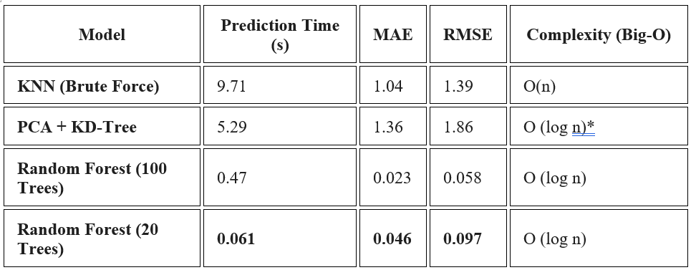
Result Obtained (Performance)
Algorithmic optimization drastically reduced prediction time from 9.71 seconds to 0.061 seconds, a significant 150x speed improvement. This validates the critical role of DAA concepts in practical machine learning.

